Slide 1
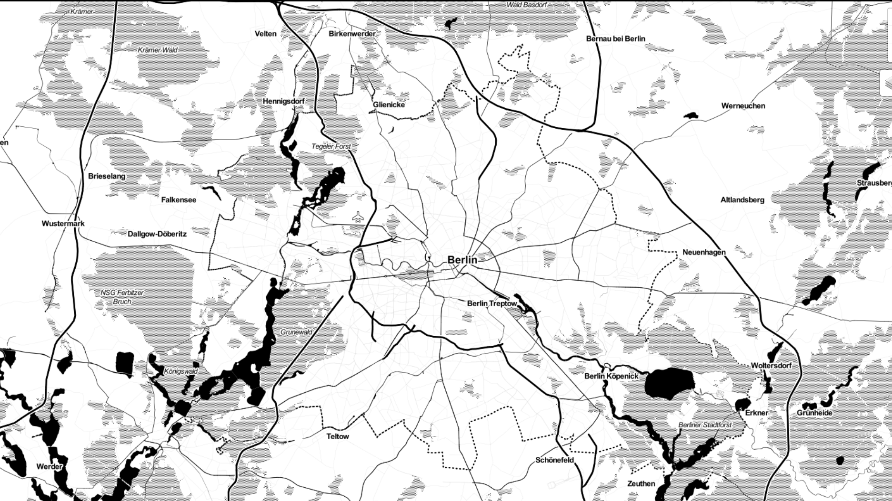
Berlin Traffic AccidentS
Interactive
Visualization
Exploring the Dangers of Berlin
Paul Kollhof
07.10.2022 – Berlin

Slide 2
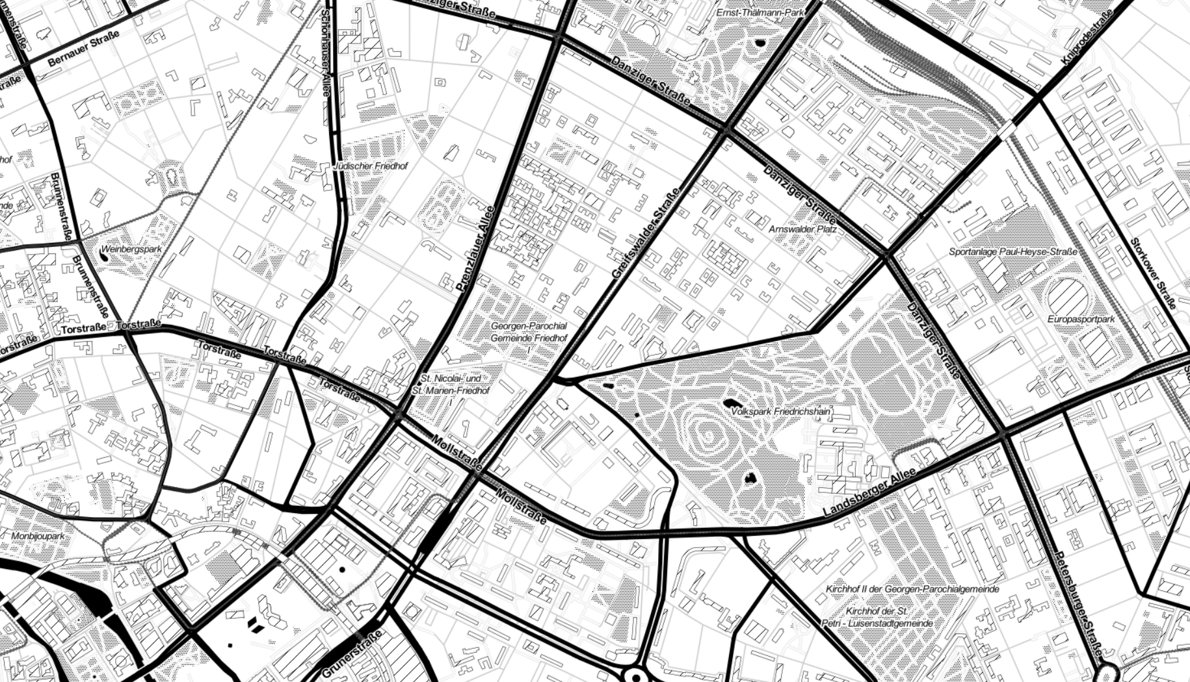

Data
OpenDataBerlin (www.daten.berlin.de)
Traffic accident data from 2018-2021
Registry of ~ 50.000 traffic accidents
Visualization
Geopandas, Folium
OpenSreetMap API

Slide 3
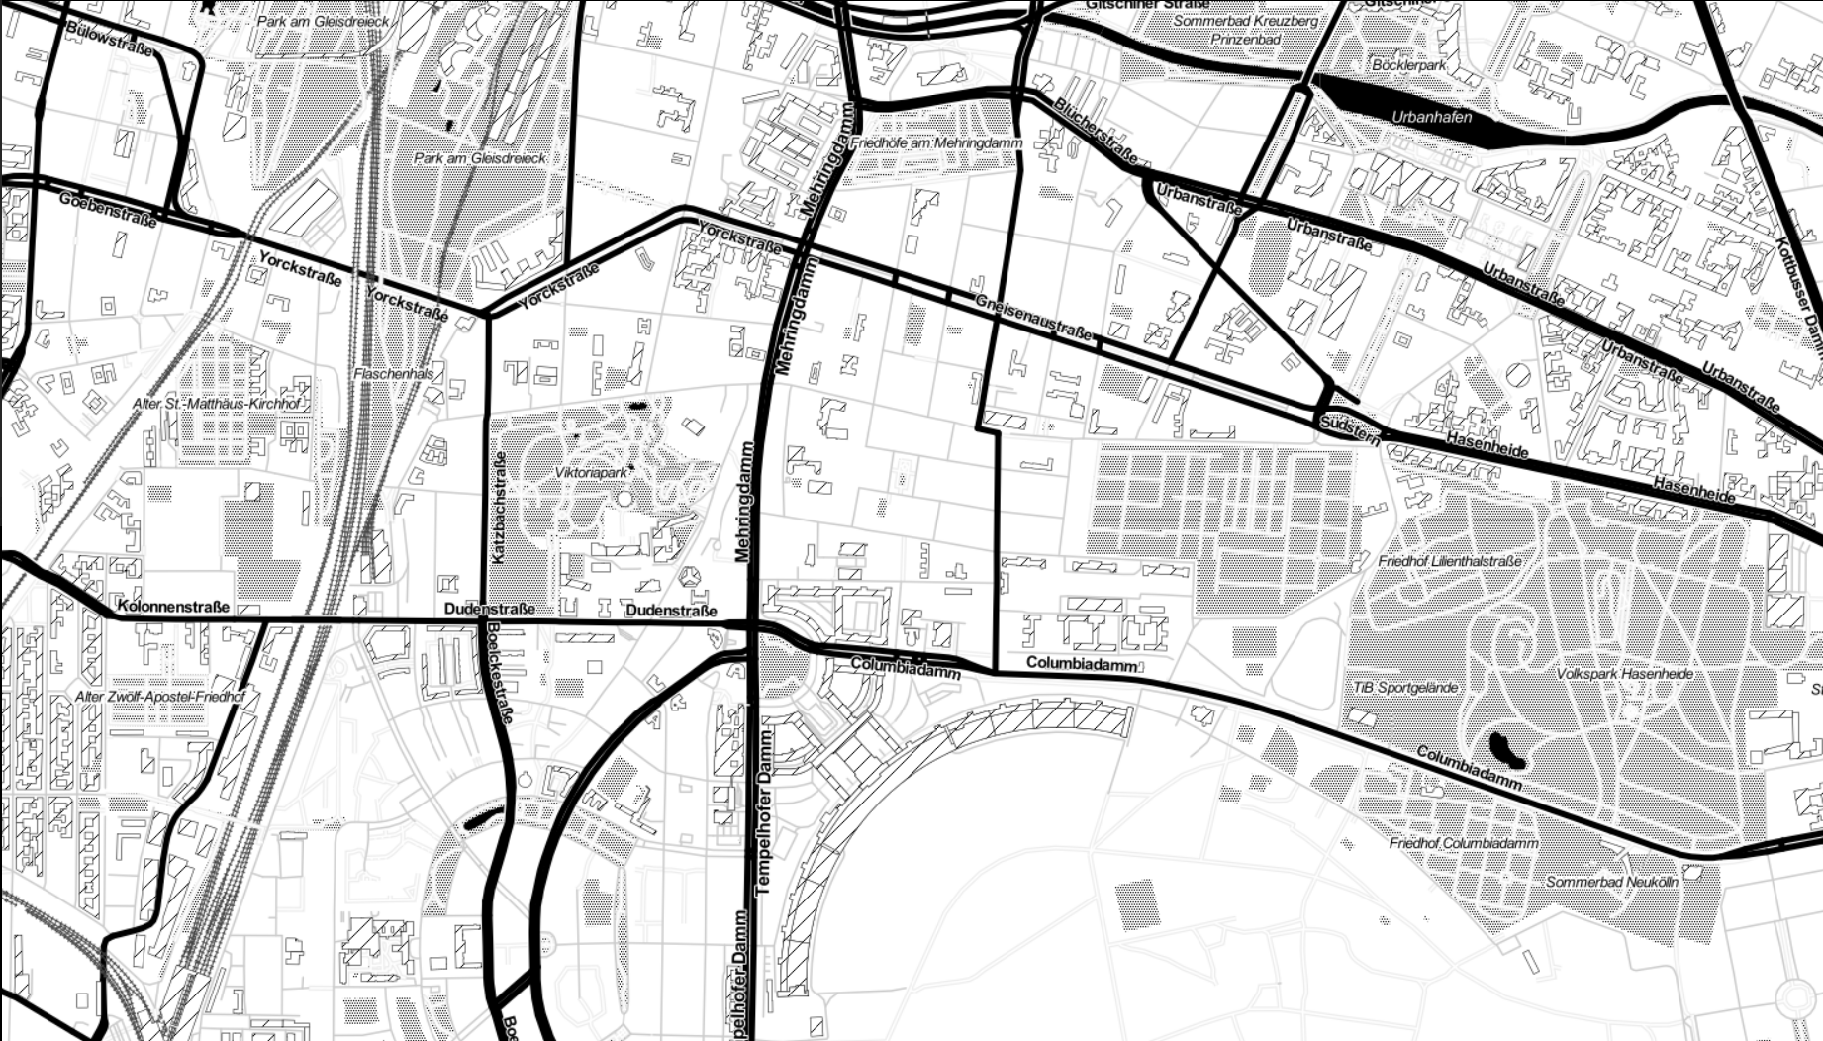

Who cares
Loves data, stats and numbers
Wants to explore Berlin by bike
Needs to know where and in what way it is dangerous

Slide 4
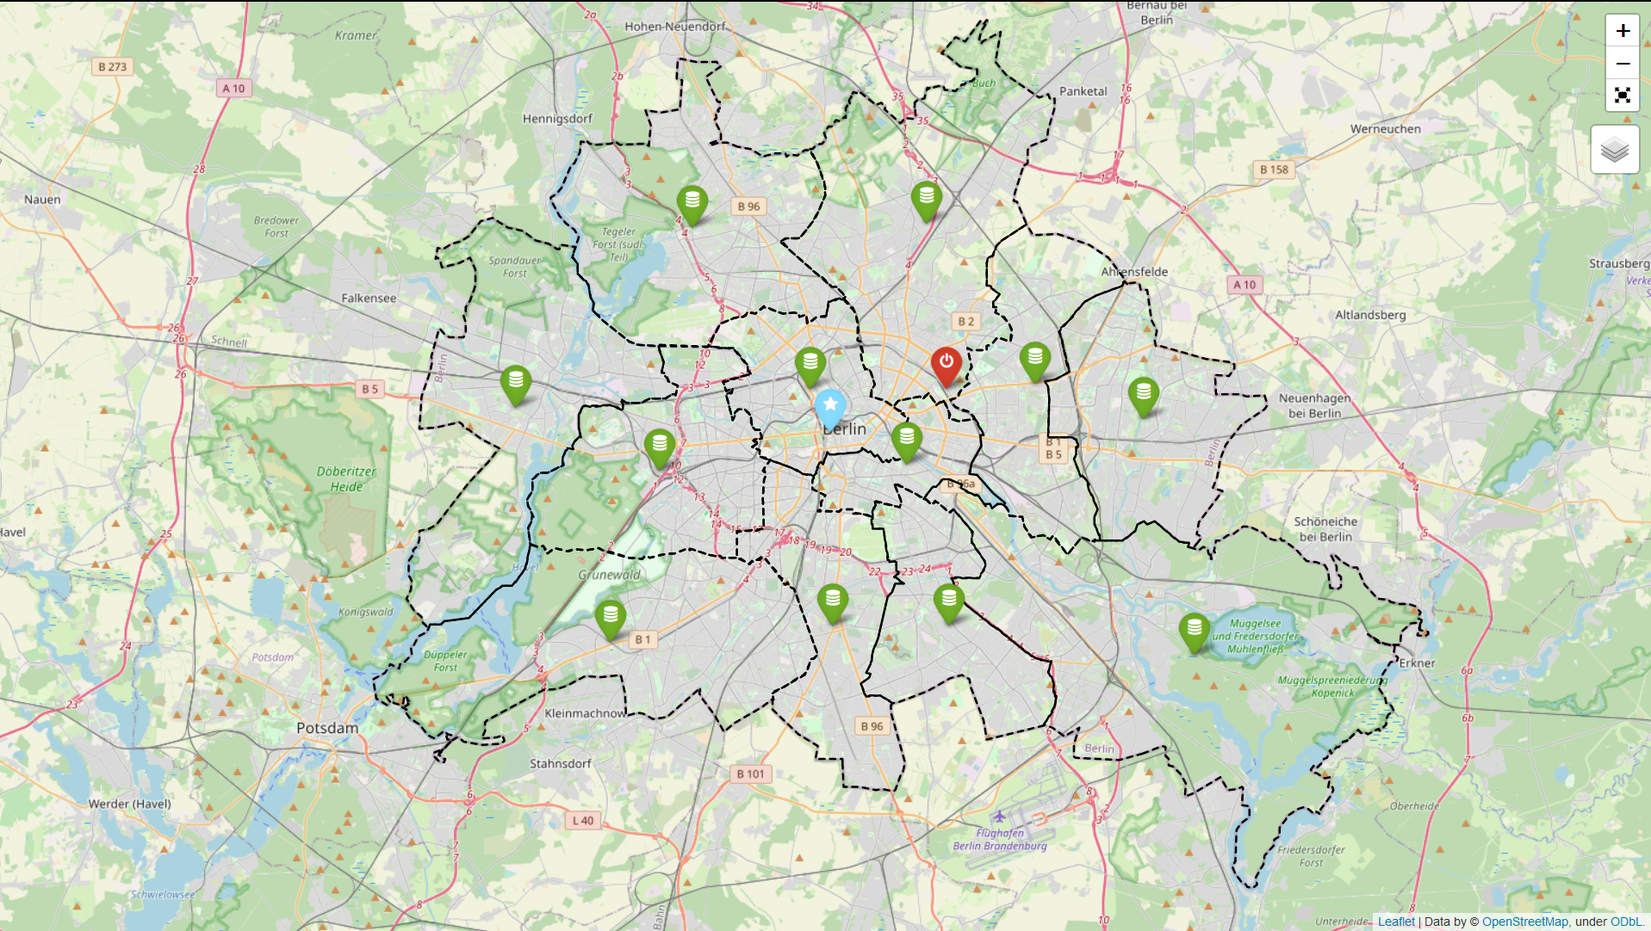

Slide 5
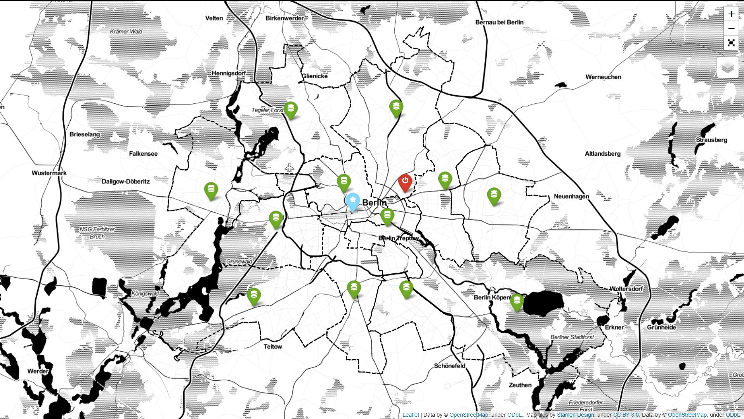

Slide 6



Data-Markers
District stats
City stats
Ironhack

Slide 7
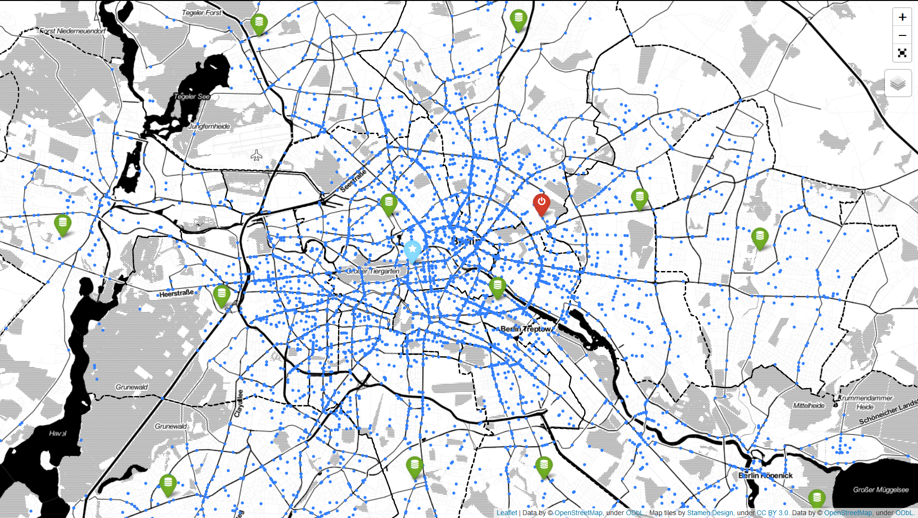

Slide 8
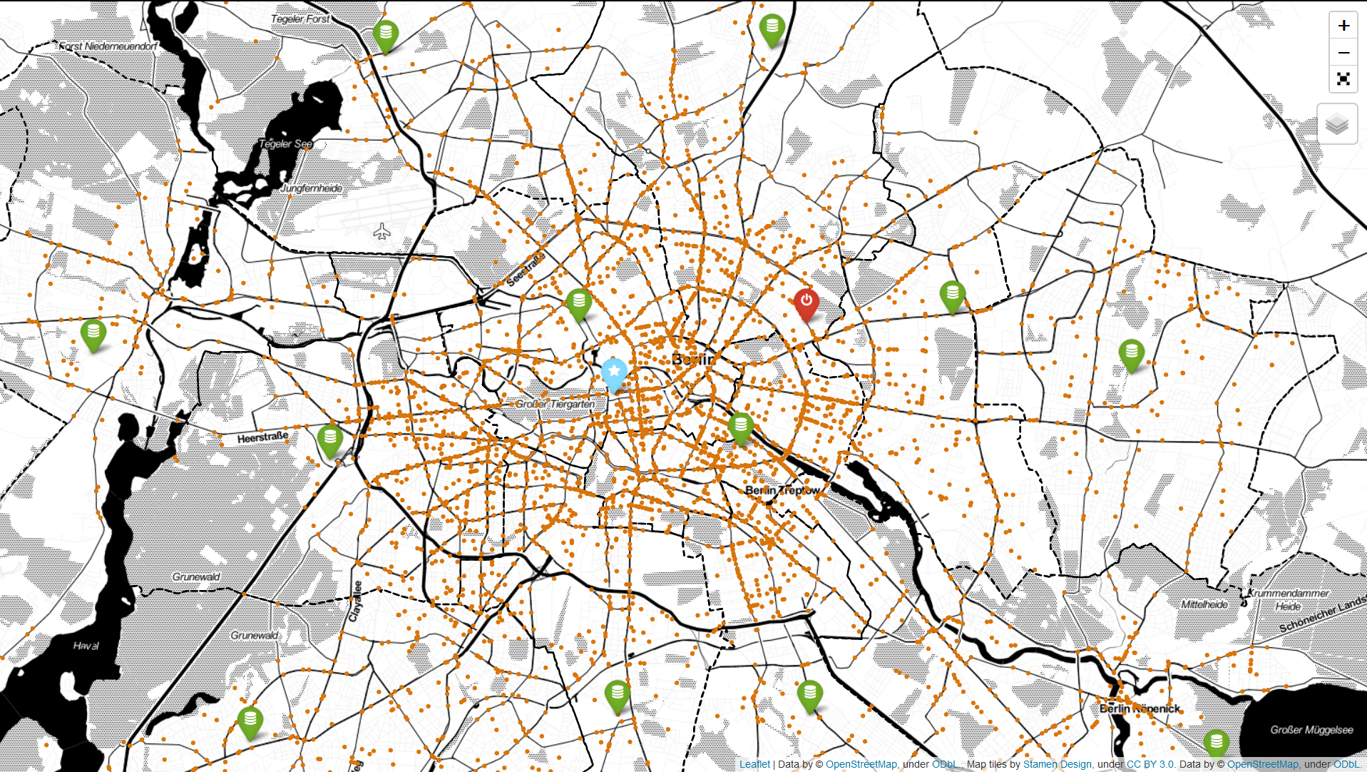

Slide 9
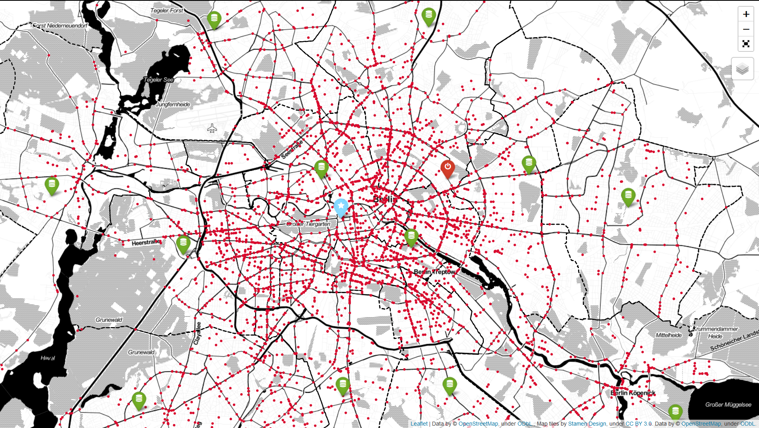

Slide 10
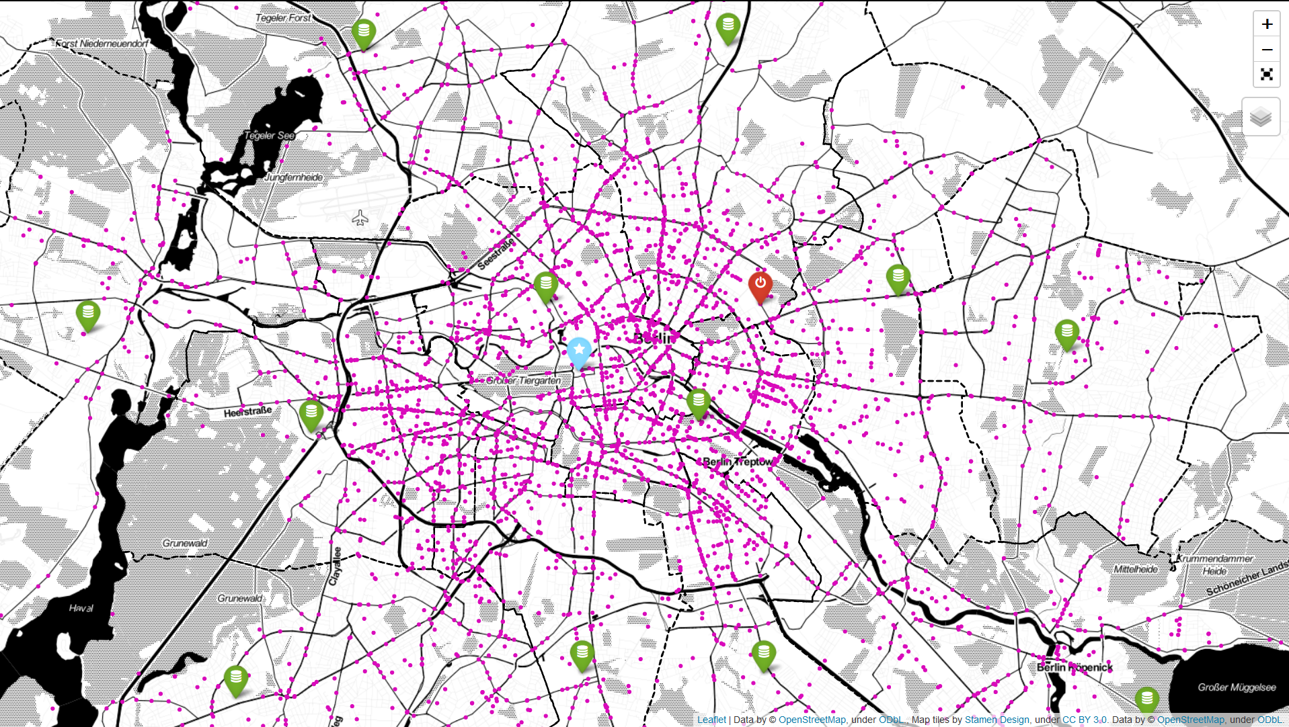

Slide 11
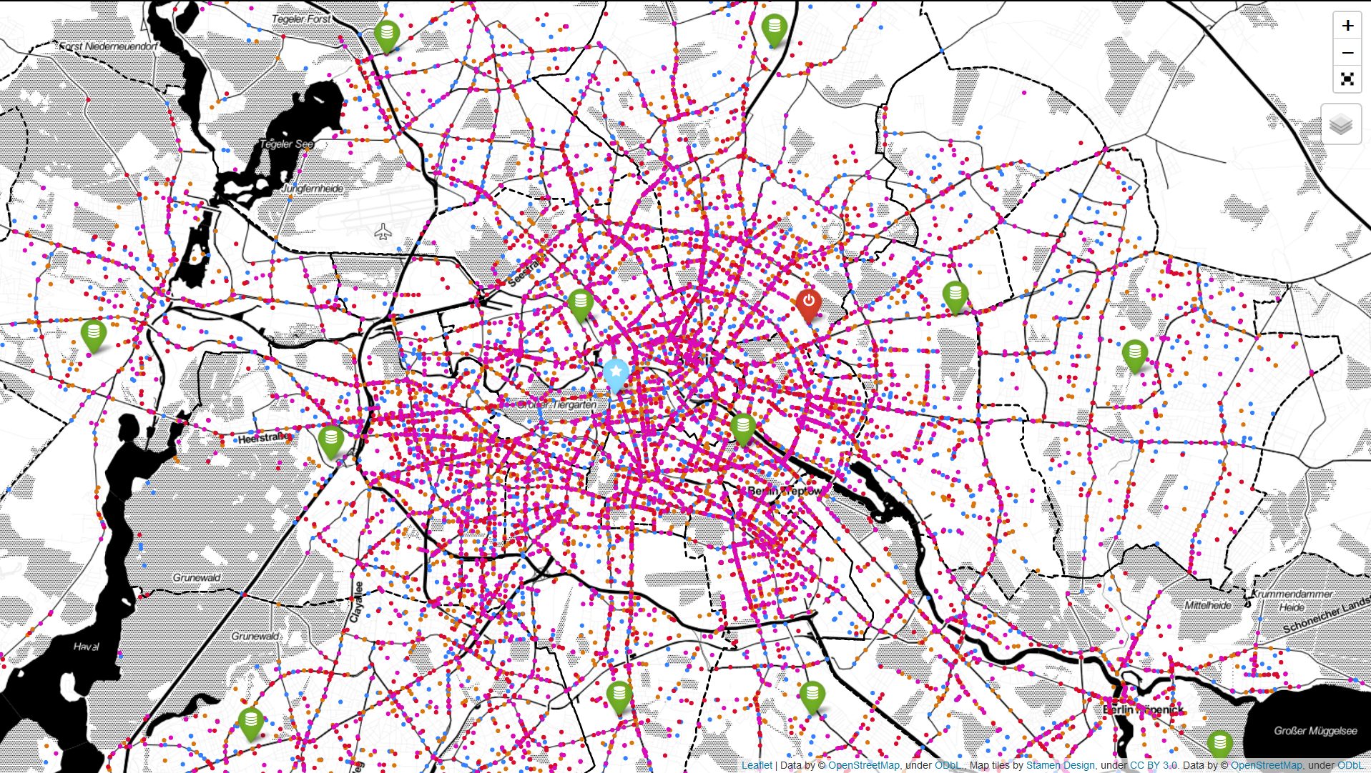

Slide 12
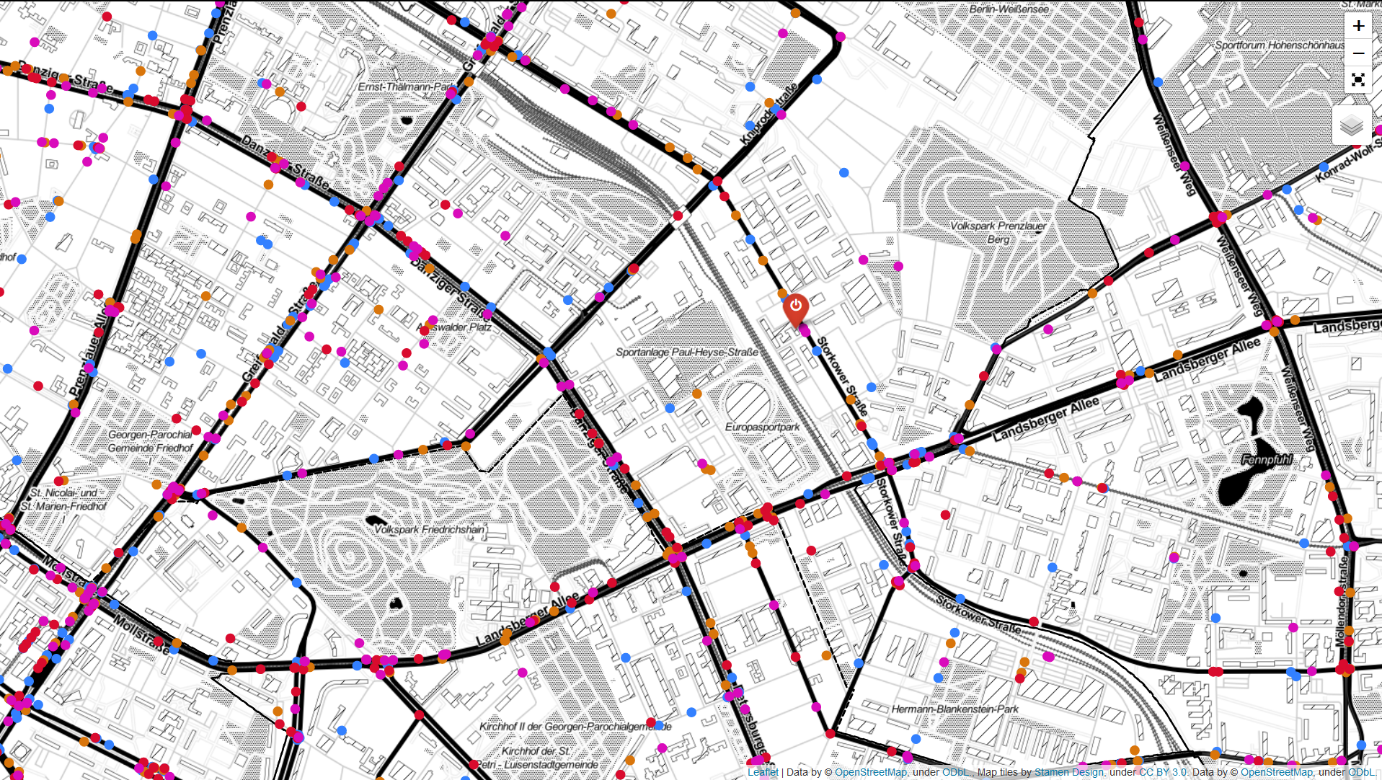

Slide 14
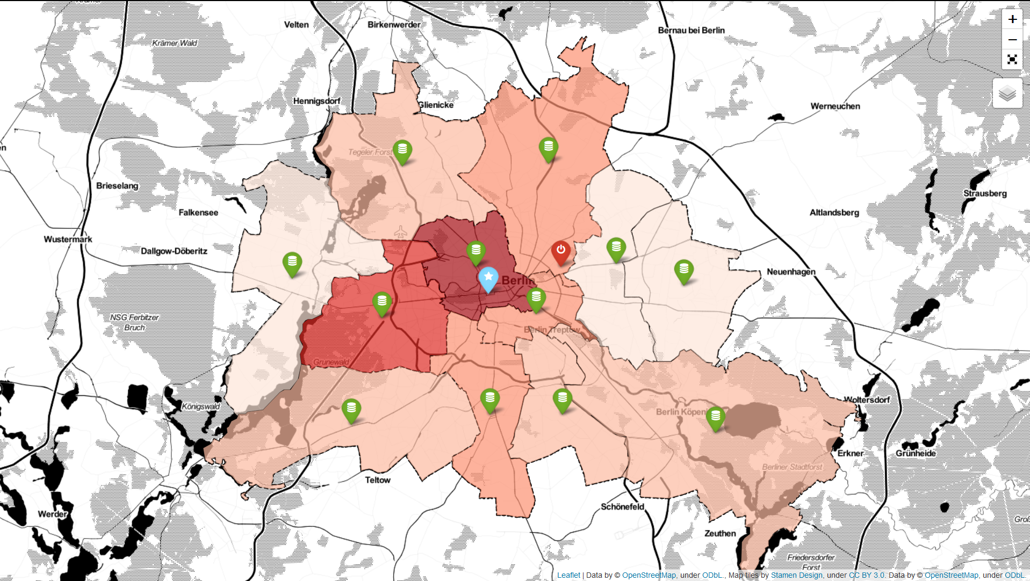
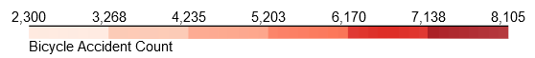

Slide 15
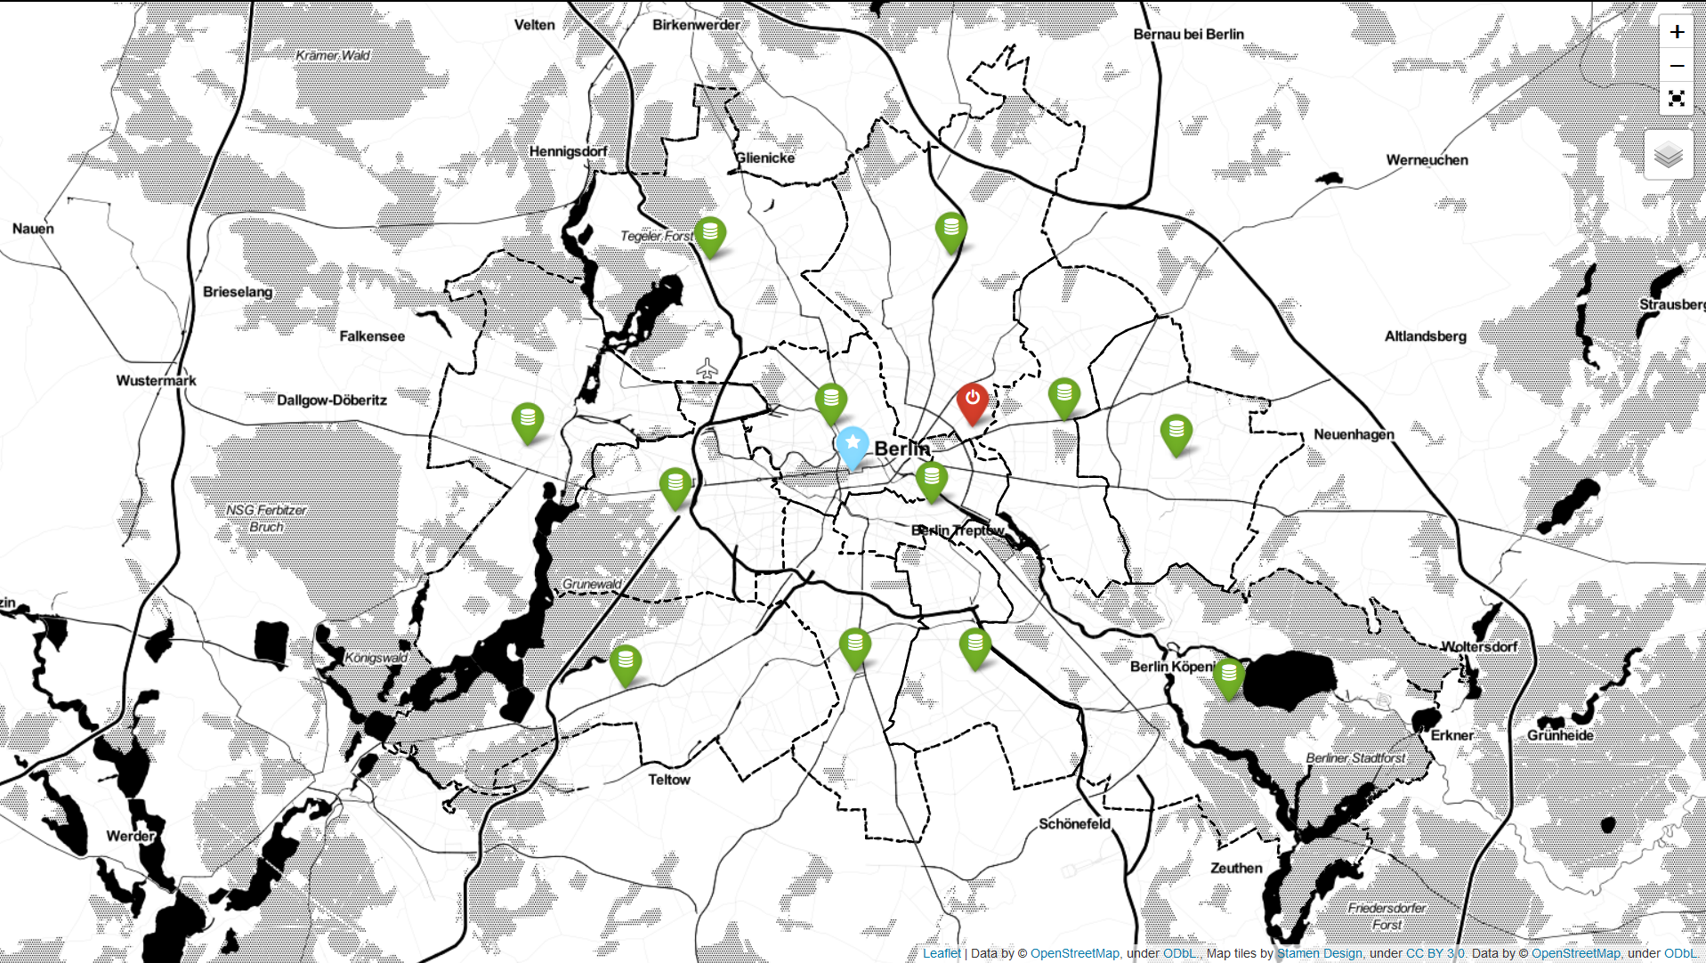
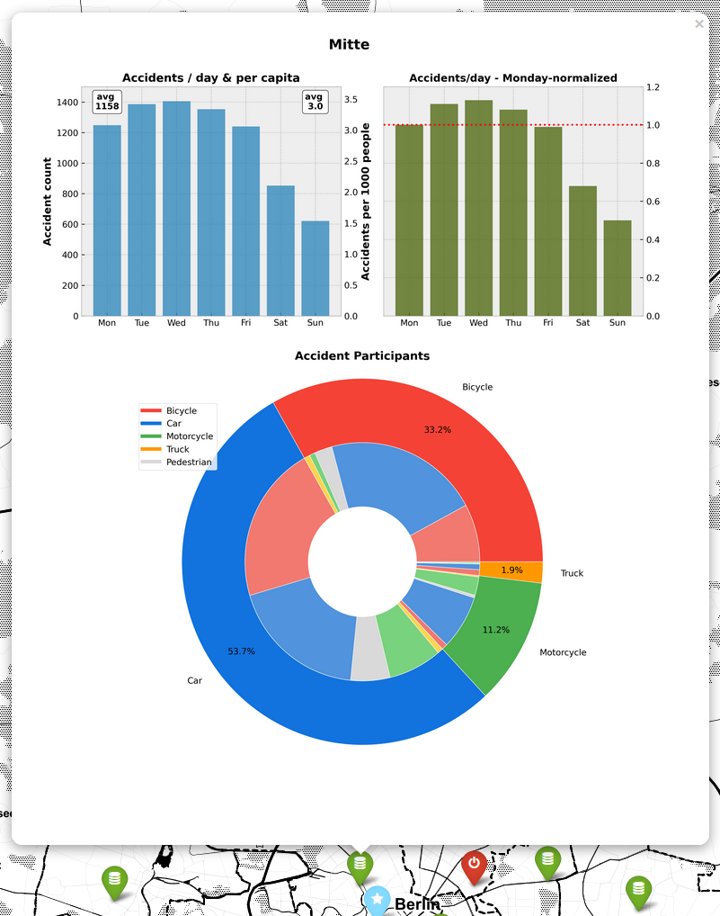

Slide 16
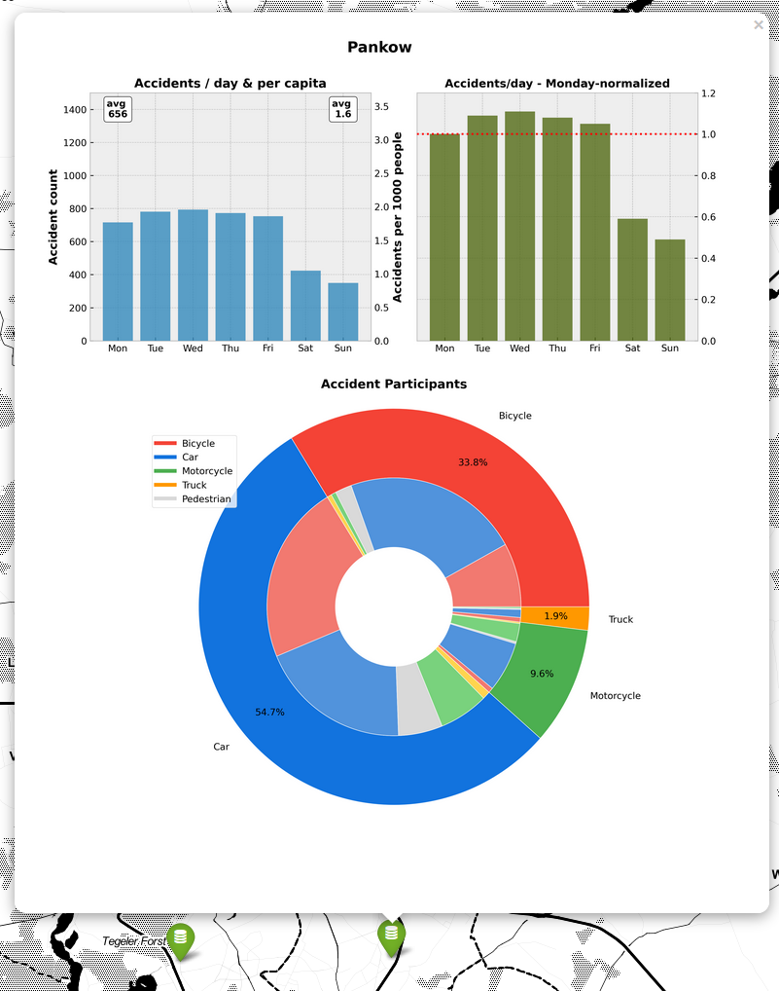

Slide 17
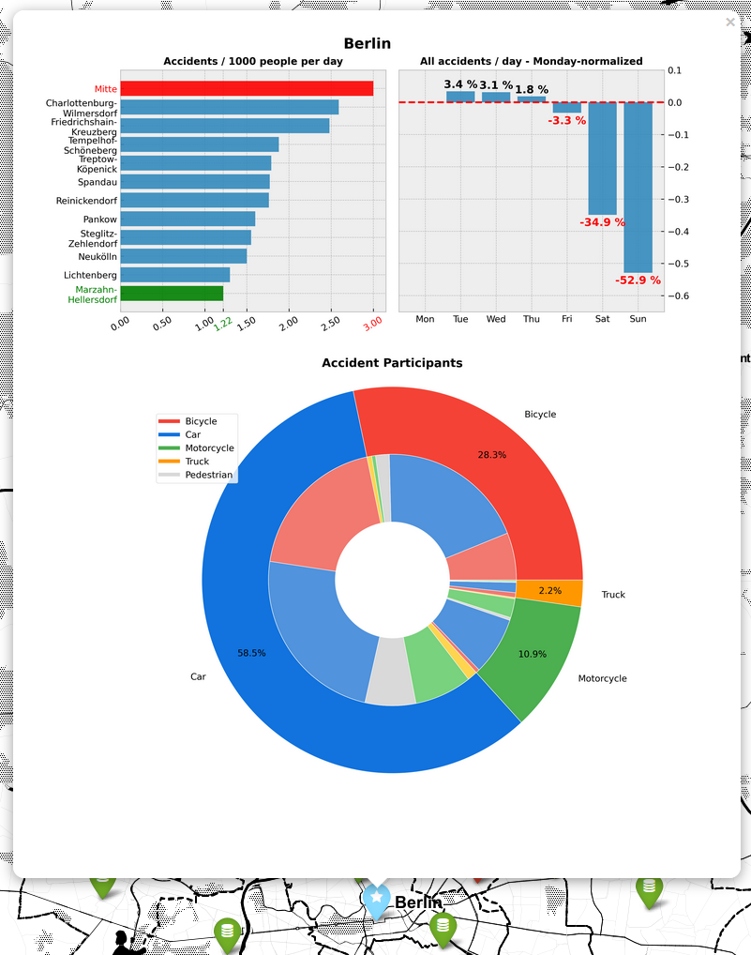

Slide 18
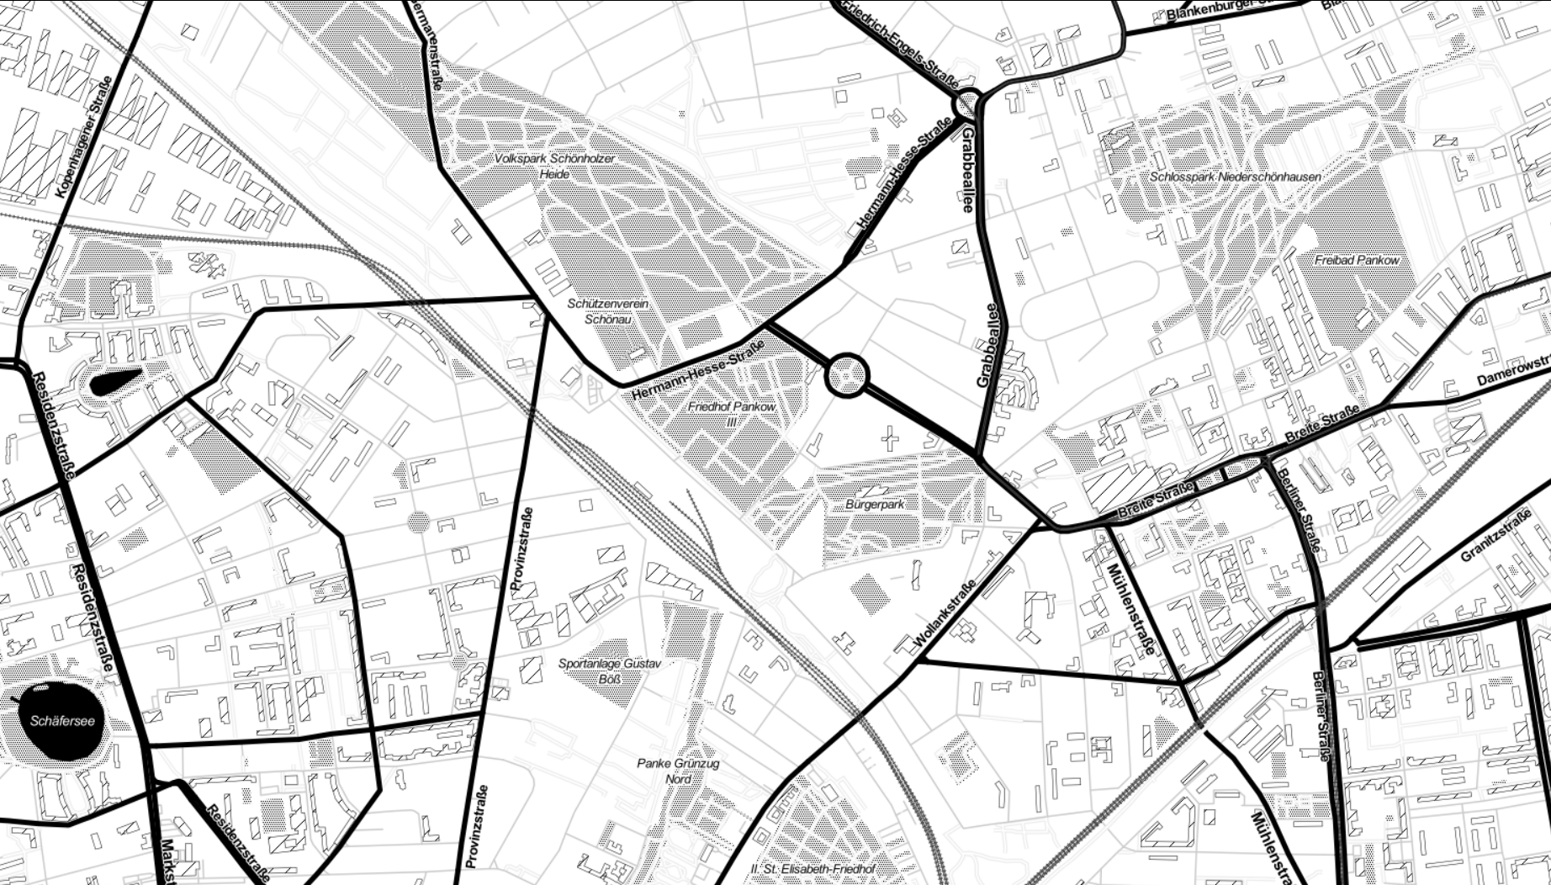
Outlook
Accident-avoidant routing
Display accident details
???

Slide 19

Berlin Traffic AccidentS
Paul Kollhof
Interactive
Visualization
THANK
YOU

